Slide 1

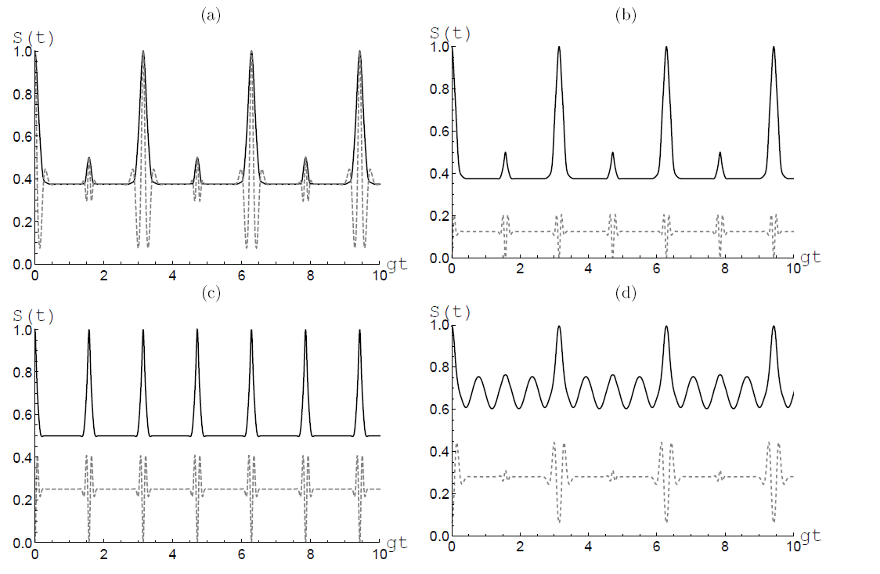
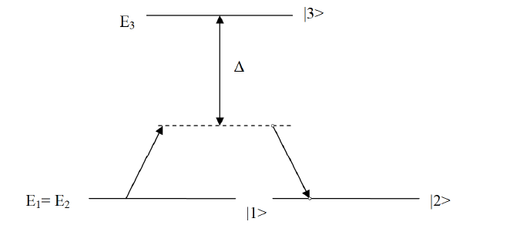


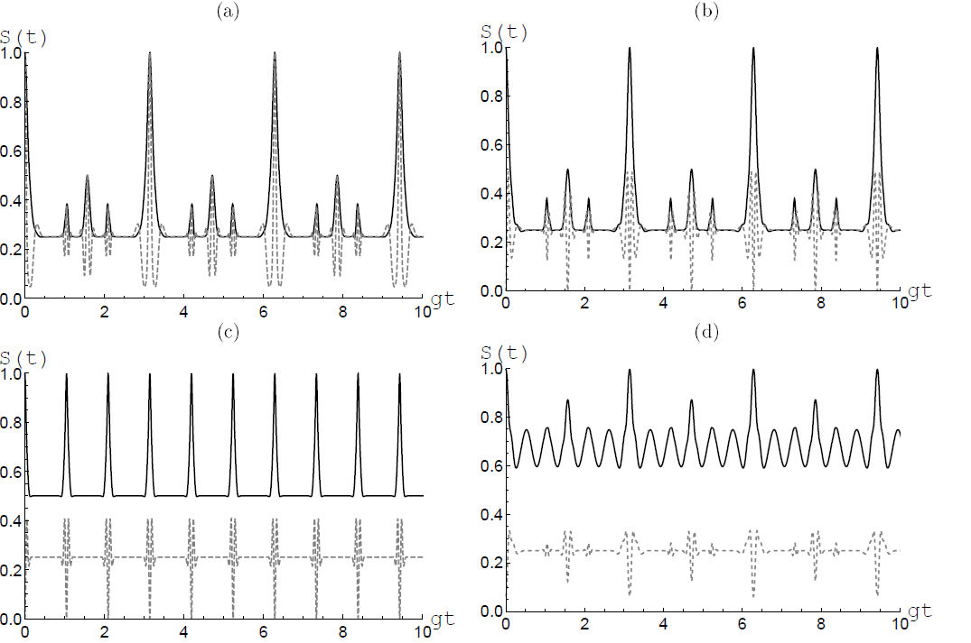
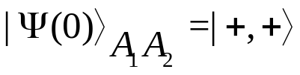
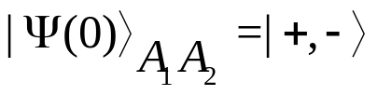
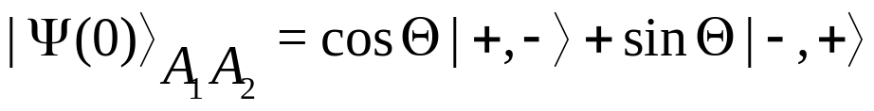

Atom-field entanglement in two-atom model with degenerate two-photon Raman transitions
Rodion Zakharov, Ali Othman and Eugene Bashkirov
.
.
.
Samara National Research University
1
Model description
The system consists of two identical qubits interacting with a one-mode thermal cavity mode
Atoms have two degenerate energy. The atoms interact through the virtual levels
The atom-field coupling is differenet (thus we take into account the dependence of the spatial structure of the cavity mode)
The atoms are asumed to prepared in separable noncoherent, separable coherent or entangled initial states
The field is in coherent state
Assume that the total atom-cavity interaction time is considerably less than the cavity lifetime and that we can ignore the effects of cavity dissipation
2
Computer modelling
Hamiltonian
Thermal initial field
Linear entropy vs g₁t. Mean photon number 10. Identical atoms. The atomic states: (1) a), (2) b), (3) c) with and (4) d) with
Atoms initial states (Bell’s type)
(1)
(2)
(3)
(4)
Entanglement calculations
Linear entropy)
The same as in previous Figure but for nonidentical atoms with g₂=2 g₁
Samara, Russia SFM-2018

