Slide 1


Machine learning applications for spectral analysis of human exhaled air for early diagnosis of diseases
Authors:
Golyak I.S., Fufurin I.L., Sherbakova A.V., Kareva E.R., Anfimov D.R., Morozov A.N.
Speaker:
Kareva Elizaveta Romanovna,
Bauman Moscow State Technical University

Slide 2
Research goal
Development of scientific foundations, creating experimental setup and mathematical methods for analyzing human exhaled air and other human excreta using infrared laser spectroscopy using quantum cascade laser for early diagnosis of diseases.

Slide 3
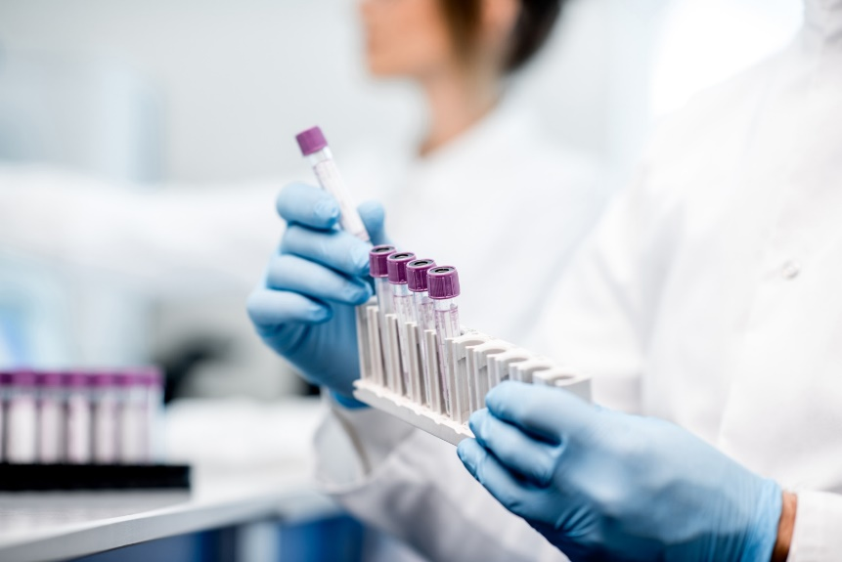

The relevance of research
Recent research has shown that human exhaled breath contains more than 1000 volatile organic compounds (VOCs). There are biomarker substances for certain diseases among them. The achieved sensitivity of laser infrared spectroscopy makes it possible to detect biomarker substances at the (sub-ppm) - ppb levels for early disease diagnosis.
Relations between biomarkers in exhaled breath and human diseases
SUBSTANCE | DISEASE
CS₂ | Cardiovascular diseases, Asthma, Oncology
Pentane ( CH3(CH2)3CH3)
Methylated hydrocarbons
NO
Ethylene (C₂H₄) | Asthma incomplete remission or exacerbation, inflammation of the airways and esophagus, oncology and metabolic syndrome
Ethane (С₂Н₆)
Methyl formaldehyde CH₃-CHO | Liver disease
Carbonyl sulfide (OCS)
Ammonia (NH3) | Kidney disease
Acetone (CH₃—C(O)—CH₃) | Diseases of the pancreas
Methyl nitrate (CH₃NO₃)
Methane (CH4)
Isoprene (С₅Н₈) | Cholesterolemia
Malondialdehyde, Isoprene, Phenol and Acetone | Pseudomonas aeruginosa
HCN

Slide 4
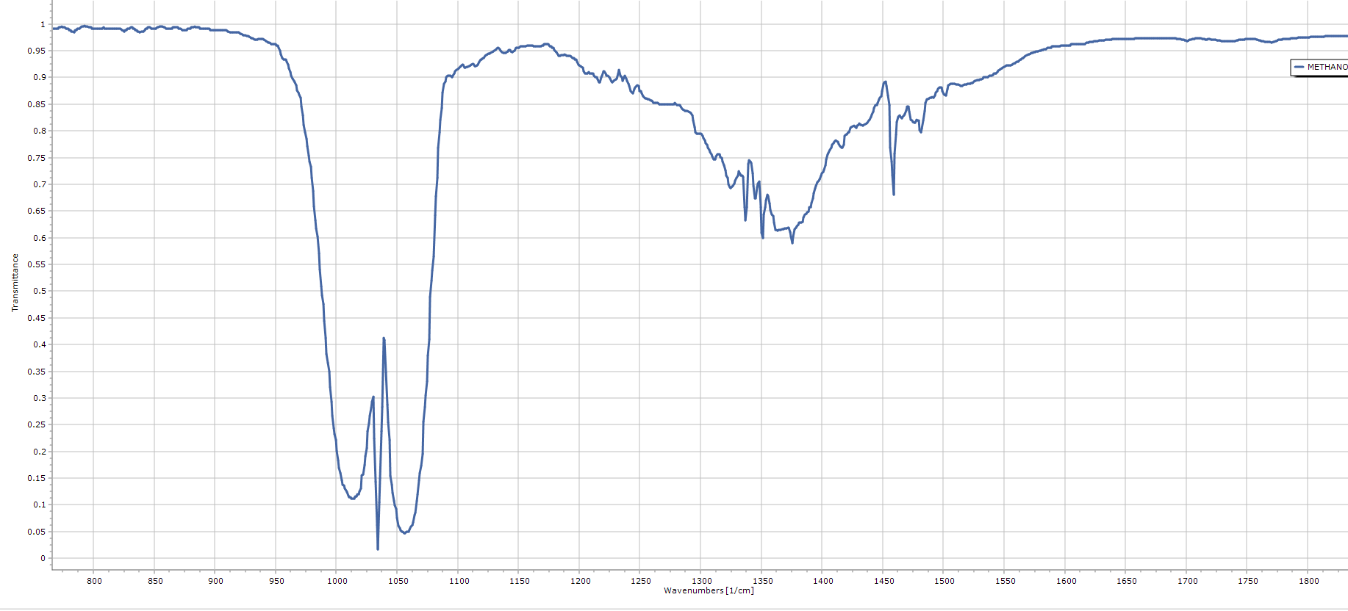
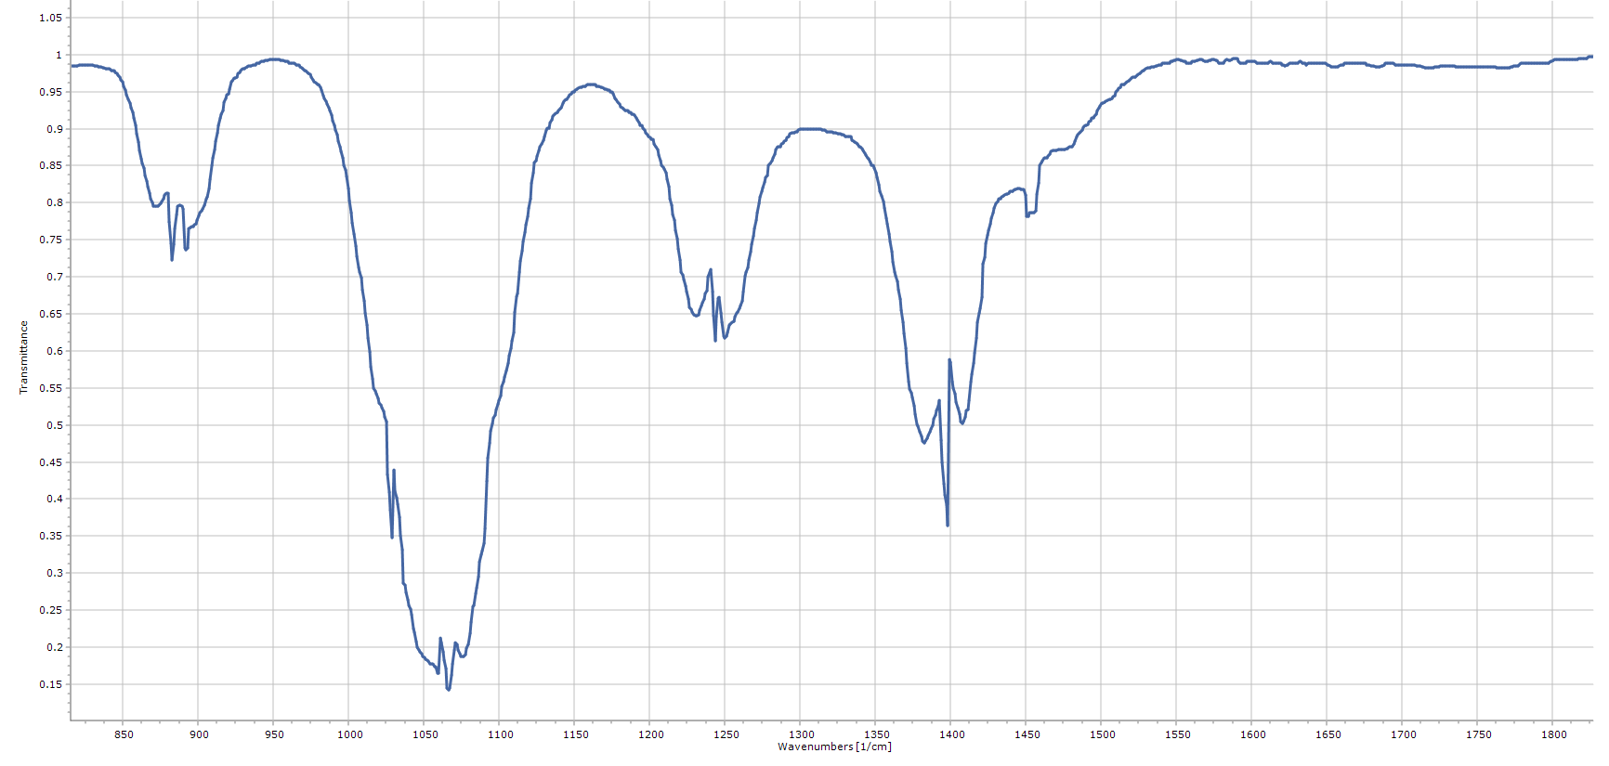
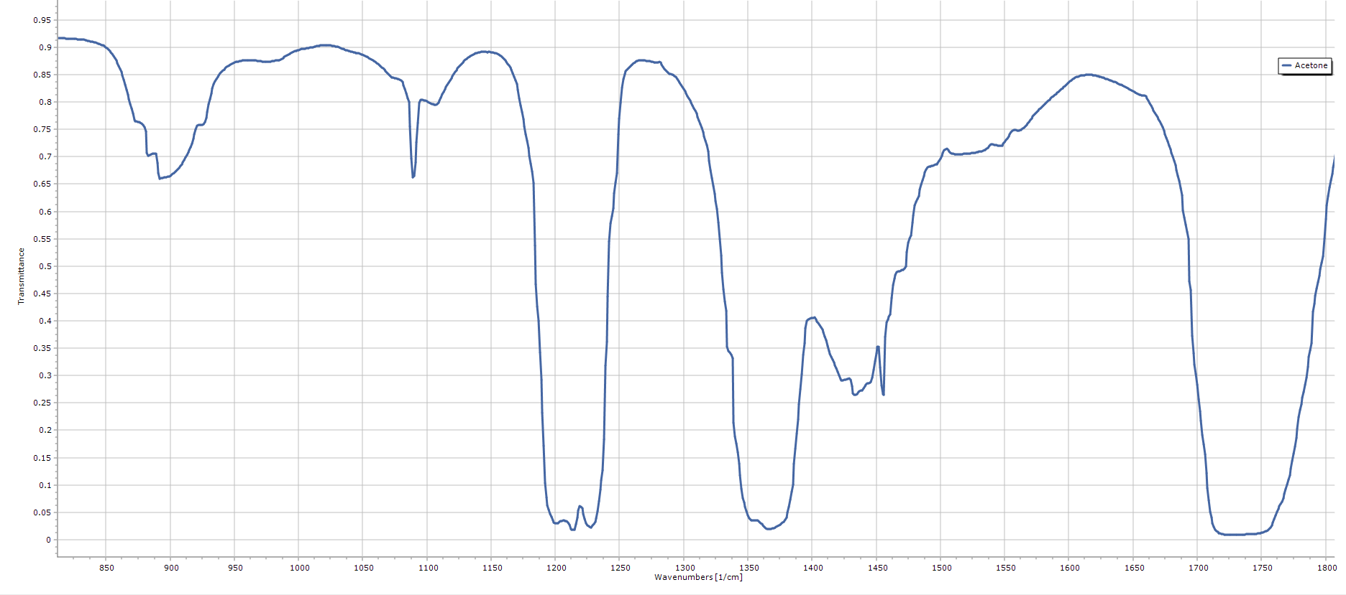
Some biomarkers in exhaled breath
SUBSTANCE | IR SPECTRA | HEALTHY | SICK
 |  | CONCENTRATION | DIAGNOSIS, CONCENTRATION
Methanol |  | 450 ppb (32–1684 ppb) | Drinking alcohol (lasts much longer than ethanol,) 2 ppm
 |  | 0.4 ppm | Methanol poisoning (1–1000 ppm) In general, any strongly elevated concentrations
Ethanol |  | 196 ppb (0–1663 ppb) | Alcoholic intoxication >130–650 ppm
 |  | 9.6–3.1 ppb | Diabetes 45.0–14.2 ppb
 |  | ~ 0.2 ppmv 0.01–1.2 ppm
Acetone |  | 0,2–1,8 ppm | Diabetes 1.25–2.4 ppm
 |  | 148–2744 ppb | Diabetes > 1.71 ppm
 |  | 0.39–0.85 ppm | Diabetes > 1.8 ppm
 |  | < 900 ppb
 |  | ~ 477 ppb

Slide 5
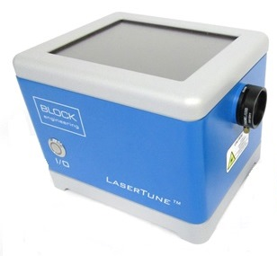
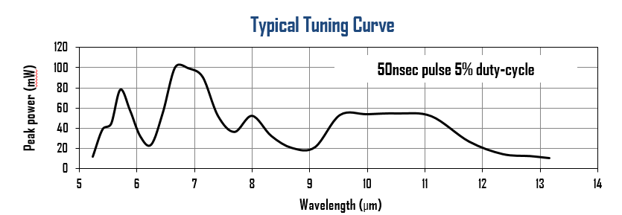
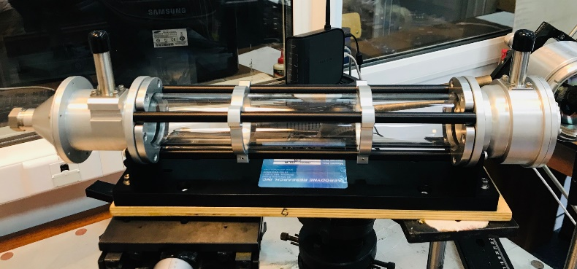
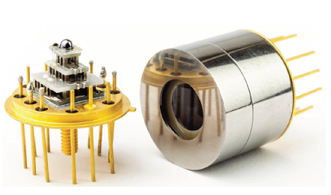
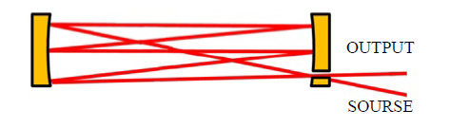
IR QC laser spectroscopy
We use infrared laser absorption spectroscopy based on quantum cascade laser and Herriot multipass gas cells.
Quantum cascade laser (QCL)
Multipass gas cell
LaserTune, Block Engineering
- Tuning mode 5.3–12.8 um.
- Peak power up to 150 mW.
- Tuning step 2 cm⁻¹
- Herriot multipass gas cell.
Volume 0.5 l.
Length 0.32 m;
Number of passes 238.
Optical path 76 m.
Output optical power up to 20 %.
The MCT (Mercury-Cadmium-Telluride) Detector Module
thermoelectrically (TE) cooled
- Detectivity D* ~ 6–8∙ 10⁹ cm√Hz/W.
- Type PVMI-4TE (Vigo, Poland).
- Detector size 1×1 mm.

Slide 6
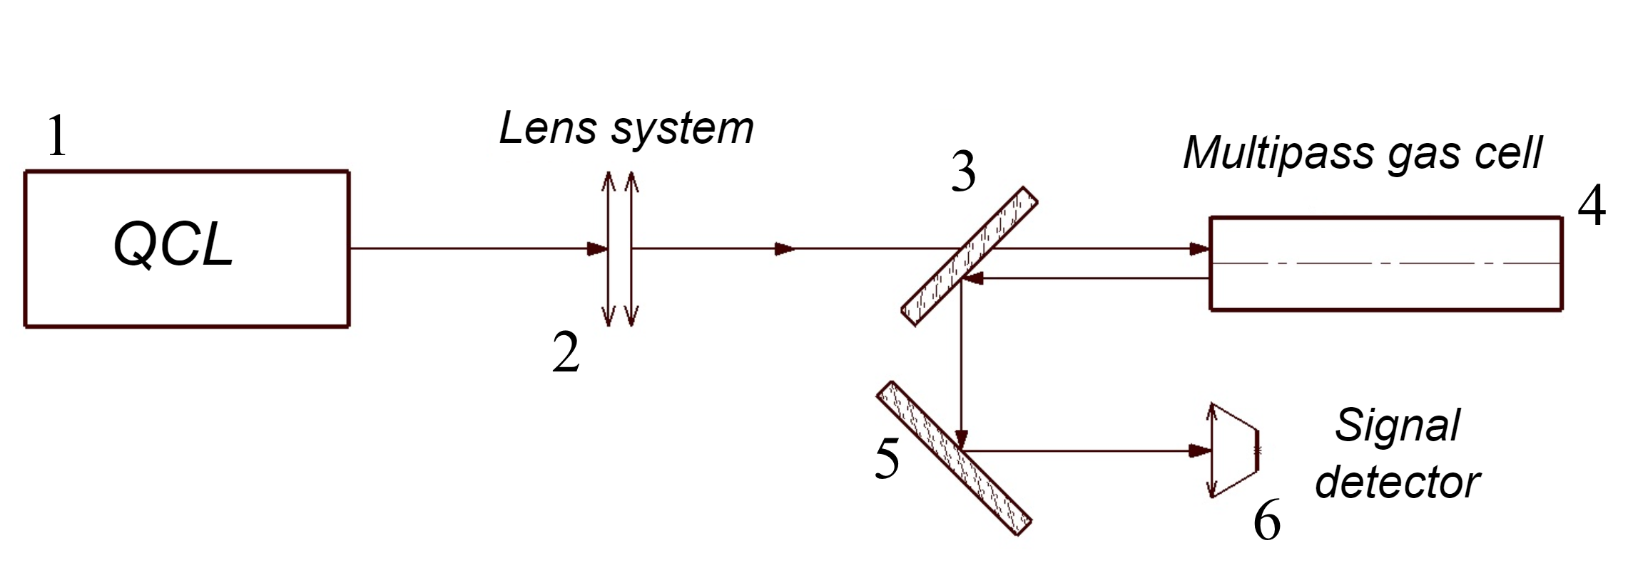
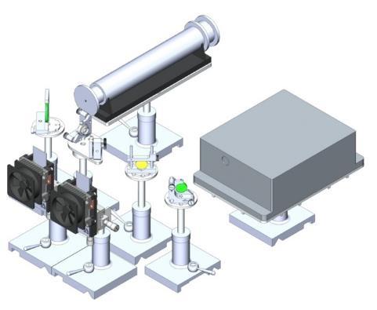
Optical unit of experimental setup for analysis of gas mixtures. Scheme with two photodetectors
1
5
2
4
3
Principal optical scheme
3D model of the optical unit
Components:
1 – Multipass gas cell. 2 – Signal MCT TE detector.
3 – Reference MCT TE. 4 – Beam splitter 80/20.
5 – QC laser.
Using a reference photodetector allows to
reduce the influence of laser power instability
(up to 5% of the peak power for Laser Tune)

Slide 7
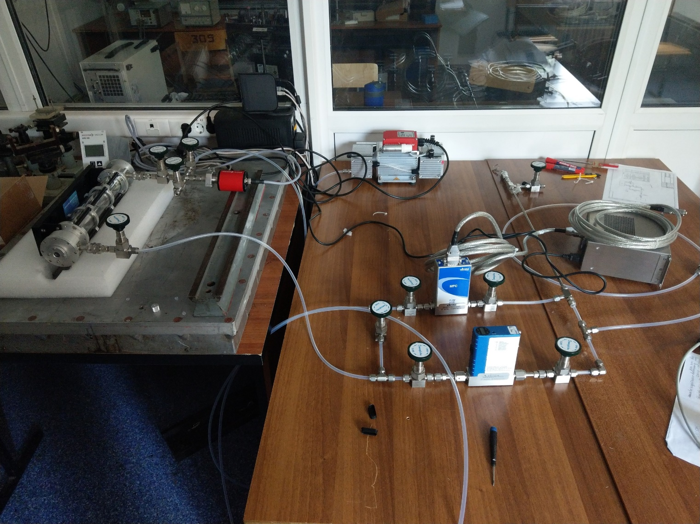
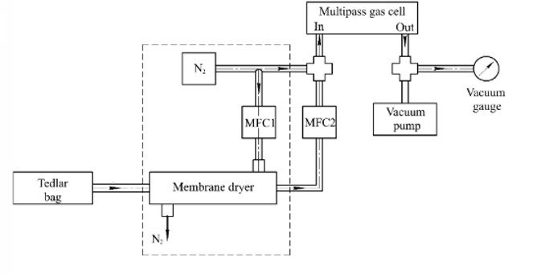
Sample Preparation
1
4
6
1
5
8
3
2
1
7
4
2
5
Components:
1 – Multipass gas cell. 2, 3 – Mass flow controllers (MFC).
4 – Vacuum pump. 5 – Nafion dryer.
6 – Vacuum gauge. 7 – Tedlar sample bag.
8 – Pure nitrogen (N2).

Slide 8

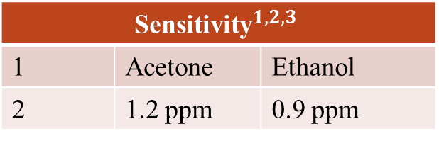
Experimental results
Sensitivity of described method
$${\text{Sensitivity}}^{1, 2,3}$$
1 | Acetone | Ethanol
2 | 1.2 ppm | 0.9 ppm
а)
b)
Spectra of a) acetone and b) ethanol. Concentrations 2 and 10 ppm
Way to increase sensitivity
Optical path length up to 76 m;
Using reference photodetector;
Sensitivity up to 100-10 ppb
${}^{1}$Optical path about 6 m,
${}^{2}$Optical scheme with one MCT TE detector
${}^{3}$ detection method – Pearson correlation
Relations between signal to noise ratio and concentrations (ppm) in measured spectra

Slide 9


Bayesian estimation for spectral analysis
$$Wc = y$$
where W – the matrix of the system with dimension M×N; c – the desired column vector of the mixture components' concentrations with dimension N; y – spectrum of the mixture written as a column vector with dimension M.
Conclusions:
The measurement noise vector ξ is subject to the normal distribution, uncorrelated with the measured signal, and has zero average value and correlation matrix V_{ξ} .
The priori distribution of the desired vector c is also normal to some mean value c₀ and correlation matrix N₀.
Correlation matrices V_{ξ} and N₀ are reversible (matrices V_{ξ} ⁻¹ and N₀⁻¹exists).
Then the Bayesian estimation for correlations
$$c_{B}={\left(N_{0}^{−1}+W^{T}V_{ξ}^{−1}W\right)}^{−1}{\left(W^{T}V_{ξ}^{−1}y+N_{0}^{−1}c_{0}\right)}^{−1}$$
(1)

Slide 10
Bayesian estimation
Acetone concentration, ppm | Bayesian Mean Concentrations, ppm
2 | 0.8
4 | 2.9
6 | 3.8
8 | 4.4
10 | 3.1
100 | 97.1
Ethanol concentration, ppm | Bayesian Mean Concentrations, ppm
2 | 2.2
4 | 3.4
6 | 5.8
8 | 6.7
10 | 9.2
100 | 87.1
The calculation error:
50–60% for acetone
15–20% for ethanol

Slide 11
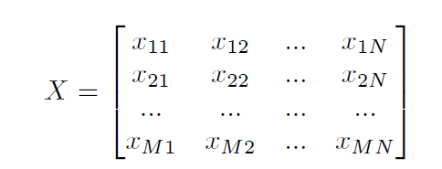





Principal components analysis
A matrix X of dimension M x N, in which M represents the number
of observations and N the number of variables
Covariance matrix
$$C_{Y}=E\left(Y⋅Y^{T}\right)$$
(5)
(2)
Decompose covariance matrix into a set of
eigenvalues and orthogonal eigenvectors
Centralization of data
$$C_{Y}=V∙Λ∙V^{T}$$
(6)
$$y_{i}=x_{i}−μ\left(x_{i}\right)$$
(3)
Mean of the sample vectors
Product of the orthonormal eigenvector matrix V
and the data matrix organized and centralized on the mean Y
is principal components vector
$$μ\left(x_{i}\right)=\frac{1}{m}\sum_{i=1}^{m}{x_{j}\left(j\right)}$$
(4)
$$PC=V^{T}∙Y$$
(7)

Slide 12
Principal components analysis
a)
b)
2 ppm
4 ppm
6 ppm
8 ppm
c)
d)

Slide 13
Linear
Discriminant
Analysis
a)
b)
Method's accuracy
0.90 (+/- 0.03)
0.90 (+/- 0.03)
1.00 (+/- 0.00)
1.00 (+/- 0.00)
2 ppm
4 ppm
6 ppm
8 ppm
c)
d)

Slide 14
PUBLICATIONS
1. Golyak, I. S., Morozov, A. N., Svetlichnyi, S. I., Tabalina, A. S., & Fufurin, I. L. (2019). Identification of chemical compounds by the reflected spectra in the range of 5.3-12.8 µm using a tunable quantum cascade laser. Russian Journal of Physical Chemistry B, 13(4), 557-564.
2. Anfimov, D. R., Golyak, I. S., Tabalina, A. S., & Fufurin, I. L. (2019). Kramers-Kronig relations in spectral analysis of diffuse reflected radiation. Paper presented at the Journal of Physics: Conference Series, 1348(1).
3. Fufurin, I., Tabalina, A. S., Morozov, A. N., Golyak, I., & Svetlichnyi, S. I. (2020). Causality relations in analysis of diffuse reflectance spectra obtained by infrared quantum cascade laser. In X.-C. Zhang, Z. Huang, & C. Zhang (Eds.), 2019 International Conference on Optical Instruments and Technology: IRMMW-THz Technologies and Applications. SPIE.
4. Fufurin, I. L., Tabalina, A. S., Morozov, A. N., Golyak, I. S., Svetlichnyi, S. I., Anfimov, D. R., & Kochikov, I. V. (2020). Identification of substances from diffuse reflectance spectra of a broadband quantum cascade laser using Kramers–Kronig relations. Optical Engineering, 59(6), 1.
5. Anastasiya S. Tabalina; Dmitriy R. Anfimov; Igor L. Fufurin; Igor S. Golyak Infrared quantum cascade laser spectroscopy as non-invasive diagnostic tests for human diseases // Proceedings Volume 11359, Biomedical Spectroscopy, Microscopy, and Imaging; 113591J (2020) Event: SPIE Photonics Europe, 2020.
6. Dmitriy R. Anfimov; Igor L. Fufurin; Igor S. Golyak; Anastasiya S. Tabalina; Stefen Kurth Calculation technique of diffuse reflectance spectra using an ensemble of damped harmonic oscillators model for substances identification // Proceedings Volume 11354, Optical Sensing and Detection VI; 1135424 (2020) Event: SPIE Photonics Europe, 2020.

Slide 15
Thank you!
Any questions can be followed:
Golyak Igor Semenovich
8(919)107-90-30
Kareva Elizaveta Romanovna
8(916)070-53-24

